Slide 1

Transformer Project Using DistilBERT-base-uncased with Fine-tuning
This project uses the Yelp Polarity dataset for sentiment analysis.
We fine-tune DistilBERT, optimizing it for fast and accurate classification.

Slide 2
🔷 Introduction: The Power of sentiment analysis
Why sentiment analysis matters
It helps businesses understand customer opinions and improve services.
Challenges in text classification Dealing with informal language, sarcasm, and short texts can reduce accuracy using traditional methods.
Yelp reviews as data These reviews are a real-world, noisy dataset that reflect genuine customer opinions — perfect for testing classification models
Why Transformers?
Transformer-based models like DistilBERT achieve high accuracy in classifying text by capturing deeper contextual meaning, outperforming older approaches like RNNs

Slide 3
💡 Why Transformers Shine in sentment analysis
Understand Context Across the Entire Sentence
Self-Attention Mechanism
Highly Parallelizable
Pretrained Knowledge
Fine-Tuning Flexibility
Works Well on Noisy Text
Better Performance with Less Data

Slide 4
Why DistilBERT?
BERT limitations:
DistilBERT benefits:
Large Size: Requires significant resources.
Efficiency: DistilBERT reduces parameters and computation by 60%, ideal for resource-limited environments.
Slow Inference: Poor performance for real-time applications.
High Accuracy: Retains 97% of BERT's performance for NLP tasks.
Pretrained Model: Trained on a large text corpus, allowing easy fine-tuning for specific tasks.
Ease of Use: Seamless integration with Hugging Face for quick model fine-tuning.

Slide 5

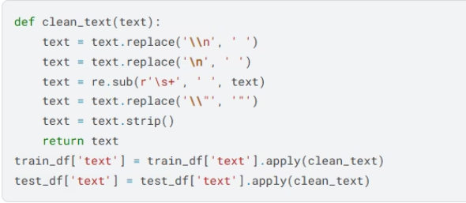
Text Cleaning Process Before Using Distil-BERT
Motivation for Cleaning
Cleaning Steps
Our dataset contains raw text reviews collected from users.
We applied a minimal but effective cleaning function:
These reviews include unwanted newline characters (\n, \\n), excessive spaces, and escaped quotes (\").
Remove duplicates:
Dropped duplicate reviews to avoid biased training and reduce noise
The goal of cleaning is to ensure a consistent and readable format without removing useful information.
Why Not Remove Punctuation or Stopwords?
Since we're using Distil-BERT, an advanced Transformer-based model, we preserve punctuation and stopwords.
Distil-BERT’s tokenizer (WordPiece) is designed to:
Understand context from the full sentence.
Use punctuation to detect tone, sentence structure, and emphasis.
Benefit from stopwords, as they help maintain grammatical meaning.

Slide 6
Tokenization Process in DistilBERT
Dataset Preparation
Load Pretrained Tokenizer
Apply Tokenization to Datasets
Converts raw Pandas DataFrames into Dataset objects.
Loads DistilBERT tokenizer (uncased version).
Tokenization transforms raw text into token IDs and attention masks. We ensure consistency by padding and truncating to a fixed max length of 256."
Based on WordPiece subword algorithm.
Required to use Hugging Face tokenizers and training pipeline.
Ensures compatibility with the pretrained DistilBERT model.
Final Cleanup for Model Training:
Hugging Face Trainer expects labels column.
Remove Raw Text Column
After tokenization, raw text is no longer needed.
Keeps dataset clean and efficient for training.
Finally, We prepare our data by converting it to Hugging Face format, tokenize it using the DistilBERT tokenizer with fixed-length inputs, and finally clean up the dataset by renaming and removing unused columns to make it ready for model training.

Slide 7
Evaluation Metrics
Accuracy
Precision
Recall
F1-score
Measures the overall correctness of the model’s predictions.
Focuses on the proportion of true positives among positive predictions.
Captures the ability to find all relevant positive samples.
Balances precision and recall to provide a single performance measure.

Slide 8

Training Setup and Process (Part 1)
Training Parameters
Loss Function
Optimizer
- Evaluation strategy & Saving strategy & Logging strategy : Epoch - Logging directory: ./logs - Load best model at end: True - Metric for best model: Accuracy - Precision: FP16
Used cross-entropy loss to optimize the model for binary sentiment classification.
AdamW optimizer with weight decay to avoid overfitting

Slide 9
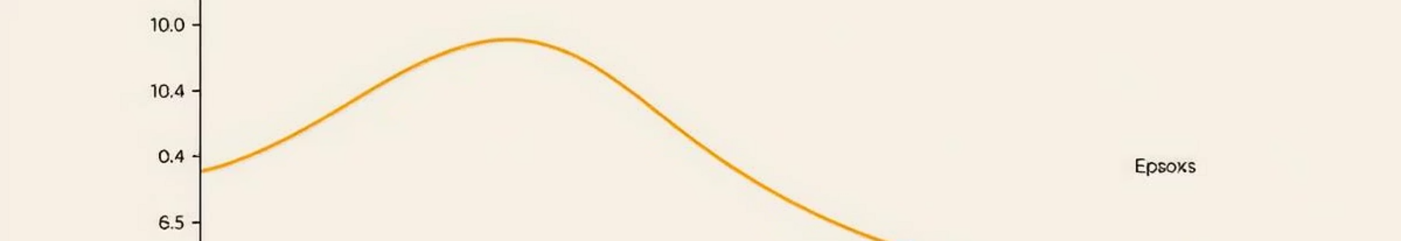
Training Setup and Process (Part 2)
1
Training Parameters
2
Validation
3
Early Stopping
- Output directory: ./results - Number of training epochs: 6 - Training batch size: 16 per device - Evaluation batch size: 64 per device - Report to: None
Evaluated after each epoch to monitor overfitting and accuracy.
Stopped training early if performance plateaued to save resources.
4
Learning Rate
Used a warmup then linear decay schedule starting at 5e-5.

Slide 10
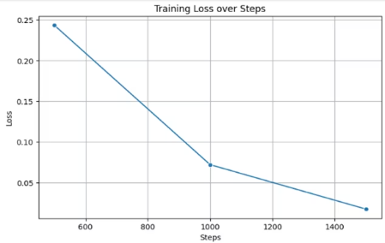
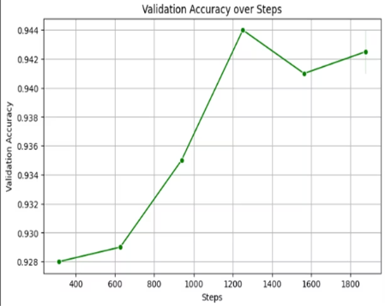
Visualization of Training Results
1. The registered request from the Trainer
• We retrieve the training log containing all the values ​​the model learned.
• We then convert this log to a DataFrame (table) so we can work on it and display it.
2. Draw a Training Loss Curve
• We only keep records that contain a loss value.
• We draw a line that shows how the loss decreases as training progresses.
3. Draw an accuracy curve on the validation data
• The exact same idea, but this time we draw an accuracy curve on the validation data.
• We see how the model's accuracy improves on data it hasn't seen before.

Slide 11

Deployment Strategy
-> Save the model and tokenizer :
• After we finish training, we save the model and tokenizer
• So, we can use them later without retraining.
-> Sentiment Prediction Function :
• This function takes a sentence from the user.
• The model generates a result, determining the class (negative or positive).
• Then we return "Positive" or "Negative" based on the highest percentage using argmax.
-> User Interface Using Gradio :
• Here, we created a simple interface using the Gradio library so
• the user can enter a comment and the form will respond to it whether it's positive or negative.

Slide 12
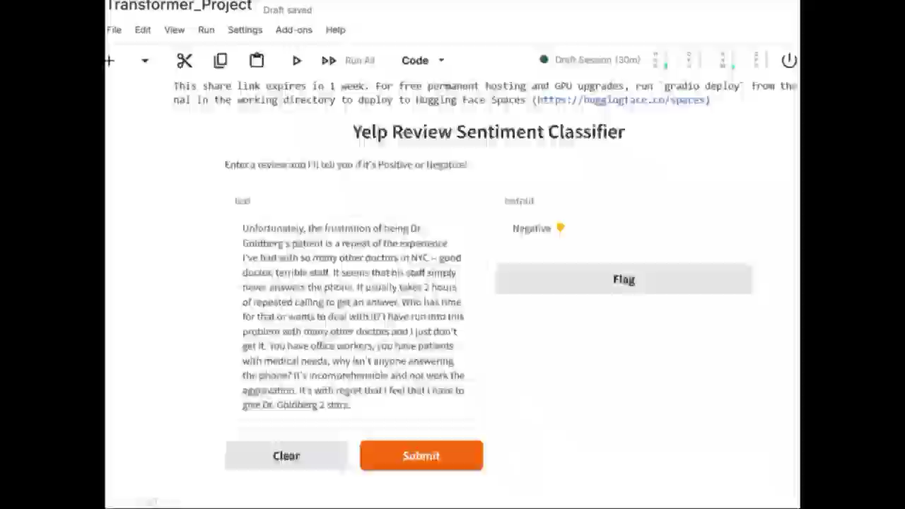

Slide 13

Thank You for Your Attention
Prepared By:
Dina Kamal
Radwa Salah
Salma Ahmed
Mariam Beshoi
Mariam Mohammed
Nada Mansour
Doaa Hazem

